Slide 1




SMART INDIA HACKATHON 2026
Automated Model for Analysis of .IQ and .wav files
  Problem Statement ID – SIH26147
  Problem Statement Title – Automated model for analysis of .IQ and .wav files along with signal parameter extraction
  Theme - Space Technology
  PS Category- Software
  Team ID -
  Team Name (Registered on portal) - Spectra

Slide 2

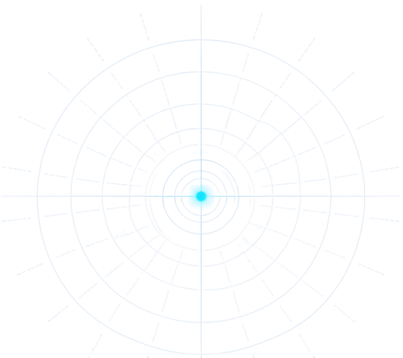

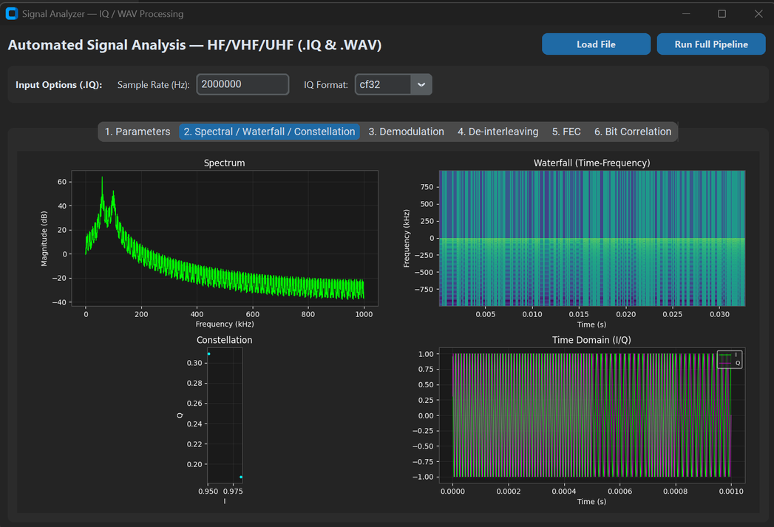
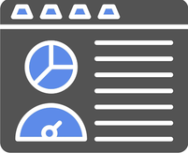
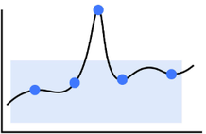
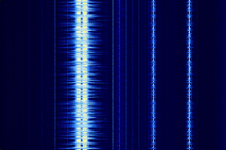
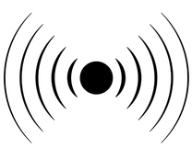
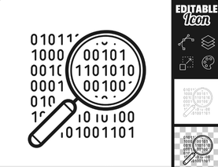

SIGNAL ANALYSIS MODEL
Spectra
Problem at Hand
Our Solution
Key Features
When a .wav or .IQ arrives, the analyst typically:
  Opens it in an SDR / spectrum tool
  Looks at spectrum, waterfall, constellation
  Decides sampling rate, centre frequency, bandwidth, modulation
  Types those values into the next tool (demodulator / decoder)
Graphical user interface for signal file analysis
Automated extraction of bandwidth and signal parameters
  The industry does not get information-rich, repeatable outputs from mixed IQ/WAV captures.
  Feature visibility (spectrum, waterfall, constellation) is also limited unless a dedicated GUI is used.
Spectral, waterfall, and constellation data visualization plots
AI IoT Based Portable Smart Cotton Picking and Crop Health Monitoring Machine
Demodulation support for multiple frequency and phase schemes
Why We Stand Out
Our target is to build a GUI-based pipeline that:
  Accepts .IQ or .wav as input
  Identifies signal parameters (sampling frequency, modulation, FEC, interleaving, plus bandwidth and SNR where feasible)
  Demodulates FSK, PSK and QAM
  Performs de-interleaving (block, convolutional, diagonal, pseudo-random)
  Applies FEC (Viterbi, RS, concatenated, LDPC)
  Correlates the bit stream to help locate header and payload
Why We Stand Out
Bitstream correlation for precise header and preamble detection
  One pipeline, two formats - Under one pipelime we analyse both .IQ and .wav files.
  From picture to bits, not only plots - Unile most SDR viewers,we provide a usable bit-stream(header/payload).
  Analyst-ready, not a black box - By using TensorFlow we ensure our auto-estimations are precise.
AI chatbot to help user analyse the data without headache

Slide 3








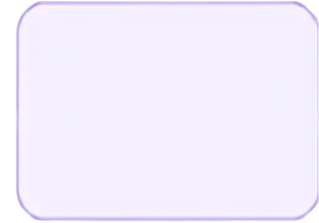








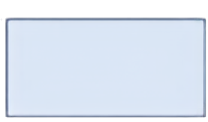
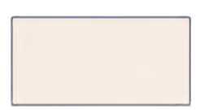
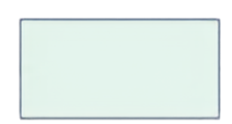

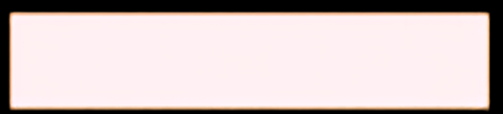
TECHNICAL APPROACH
SPECTRA
Technologies Needed
Methodology & Architecture
Signal Ingestion Load and configure RF data.
Parameter Extraction Estimate bandwidth, SNR, modulation, FEC, and interleaving.
Demodulation Convert 1/Q samples into raw bits.
FEC Decoding Correct transmission errors.
Payload Extraction Find the preamble and extract the payload.
Spectral Analysis View spectrum, waterfall, I/Q, and constellation.
De-interleaving Reorder scattered bits.
De-interleaving + FEC Decoding Chain
Demodulated Soft/Hard Bits
(Block / Convolutional / Diagonal / Pseudo-random)
FEC Decoder (Viterbi / RS) Concatenated (L&P)
Corrected
Bit-stream
Interleaver / FEC pattern is auto-detected by testing known standards against measured periodicity & syndrome checks
@SIH Idea submission
@SHIh Idea submission
Notes:
null

Slide 4
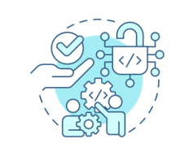

FEASIBILITY AND VIABILITY
Spectra
Feasibility Analysis
  Built from mature,
open-source
DSP techniques
  Full pipeline already
validated end-to-end
on synthetic bursts
with combined
impairments
  Modular blocks let each stage be built & tested independently, in parallel
Challenges & Risks
  Protocol structure (markers, block size, FEC type) unknown in advance
  Low-SNR captures degrade synchronisation & bit recovery
  Large .IQ/.WAV files strain memory & UI responsiveness
  Must support both offline files and future live SDR feeds
Test a known-standards library against measured periodicity & syndrome checks
Streamed block-wise processing with cached spectrogram/constellation views
Soft-decision (LLR) decoding and noise-adaptive loop bandwidth (2–3 dB gain)
Common ingestion layer abstracts file vs. stream behind one interface
Strategies for overcoming the challenges
@SIH Idea submission
Notes:
null

Slide 5
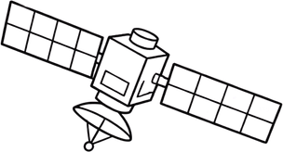





IMPACT AND BENEFITS
Spectra
Impact on Target Users
  For analysts:
Right now, figuring out what a signal is takes hours of manual guesswork. This tool does that guessing automatically, so the analyst just reviews and confirms instead of doing it all by hand.
  For research:
Because every signal gets analyzed the same automatic way every time, the results are consistent and comparable. And since the tool is built in swappable pieces, researchers can add support for new signal types later without rebuilding the whole thing.
Ground station/ SDR reciever
Spectrum monitoring station
SIGINT / RF Surveillance Unit
Proposed Analysis Tool
Identifies modulation, FEC & interleaving of captured signals --> supports satellite link verification, interference detection, and space-based SIGINT
Key Benefits
Analyst Productivity
Replaces manual parameter guesswork with automated, confidence-scored detection
Consistency
Every capture gets a header/payload correlation and a BER estimate
Reusability
Modular decoder bank extends to new modulation/FEC schemes without a rebuild
Applicability
Satellite-link verification, spectrum-interference monitoring,general
RF/SIGINT triage
@SIH Idea submission
Notes:
null

Slide 6


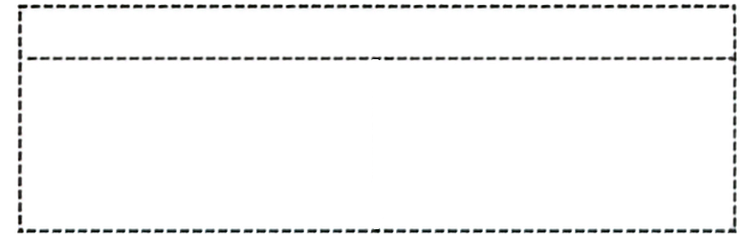


RESEARCH AND REFERENCES
Spectra
FEC, Datasets & Benchmarks
  Bernard Sklar, Digital Communications, Ch.8 — fading channels & interleaving theory
  reedsolo · scikit-dsp-comm · pyldpc — Reed Solomon, convolutional/Viterbi and LDPC decoder libraries
  SigIDWiki · RevSpace “Decode Everything” · SatNOGS DB — real-world .iq/.wav sample datasets for testing
  go2DECODE / Procitec — reference commercial signal-analysis tools for benchmarking
  Synthetic FSK/QPSK generators (NumPy + GNU Radio) — ground-truth signals for pipeline validation
References & Learning Resources
Tools, Libraries & DSP References
  PySDR — Hands-On DSP Guide (Ch.1–4: IQ sampling & frequency domain; Ch.7–10: digital modulation & sync)
  GNU Radio Guided Tutorials & GNU Radio Companion — SDR block concepts, visual signal-chain simulation for synthetic test data
  PyQt6 official docs & PyQtGraph — GUI and high-performance real-time plotting
  SciPy (scipy.io.wavfile, scipy.signal.correlate) & NumPy — file I/O, array ops, correlation
  Python bitarray & struct — bitwise operations and binary parsing
Links
  Project GitHub
  PySDR Documentation
  Dataset used
@SIH Idea submission
Notes:
null

